Slide 1
AcademicPilot AI |
DEPARTMENT OF ARTIFICIAL INTELLIGENCE AND MACHINE LEARNING
AI-Powered Adaptive Academic Guidance and Personalized Learning Platform
Submitted to
Dr. M. Soundarya Professor, Department of AI&ML, Rajalakshmi Engineering College
Presented by
PREETHI AH (231501121)

Slide 2
INTRODUCTION
AcademicPilot AI is a web based Agentic AI-powered personalized learning platform designed to provide students with adaptive academic guidance
Instead of performing like a Single Chat Box like generating Questions and responding Where each agents perform Specialized Task
AcademicPilot AI analyzes student performance, mastery, assessment results, and weak topics to recommend suitable learning activities. A central Academic Brain coordinates specialized agents such as the Detective, Resource, Strategist, Mentor, Examiner, and Progress Monitor Agents.
Teachers can create subjects and topics and upload original PDF learning resources, which students can access through the Resource Agent. Students can learn, practice, take assessments, and track their progress.
The system follows a continuous learning cycle:
Observe → Analyze → Plan → Learn → Practice → Evaluate → Update → Re-plan
Thus, AcademicPilot AI provides a personalized learning experience while helping teachers manage resources and monitor student progress.

Slide 3
PROBLEM STATEMENT
Traditional learning systems often provide the same learning content, study plans, and assessments to all students. They do not effectively identify individual weaknesses or continuously adapt learning activities based on student performance.
Students may struggle to identify weak topics, find suitable learning resources, plan their studies, and evaluate their progress. Teachers also need an efficient way to manage learning resources and monitor student performance.
Therefore, there is a need for an Agentic AI-based personalized learning system that can analyze student performance, identify weak areas, recommend appropriate resources, create study plans, provide guidance, conduct assessments, and continuously update the student's learning progress.

Slide 4
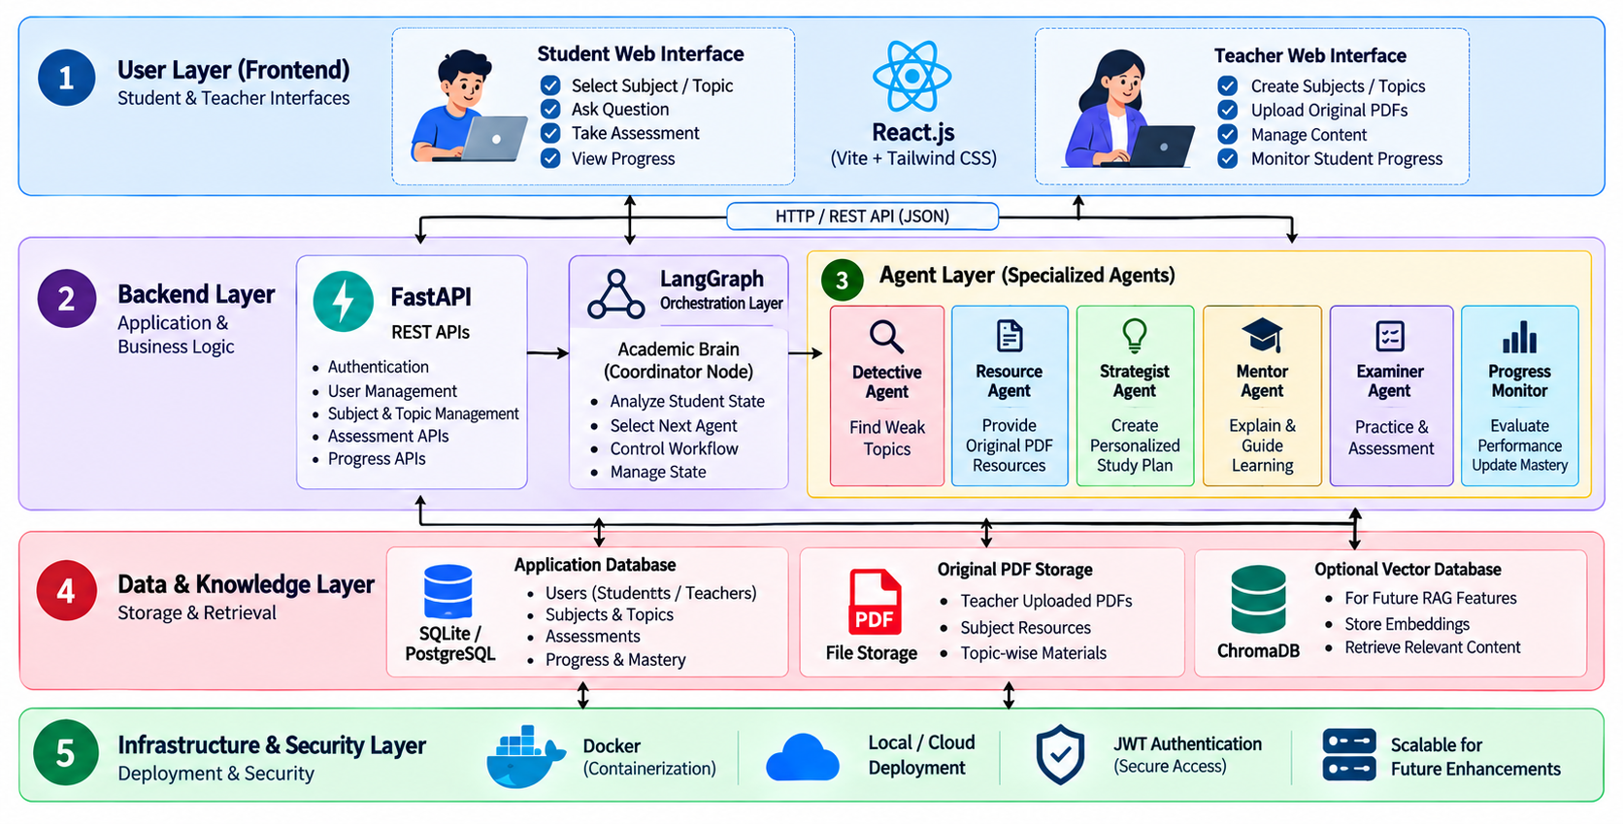
System Architecture

Slide 5
Academic brain coordinator
It controls the overall task and make decision. What each agents can do
It analyze mastery level and accuracy level of the student and provide the learning path
It is implemented as part of the LangGraph agent
DETECTIVE AGENT
It Identifies the
Weak Topic
Weak Concept
Low Mastery
Repeated Mistake
RESOURSE AGENT
The Resource Agent provides the student with learning materials uploaded by the teacher
The student receives the original document.
Strategist Agent
Based on your current performance
The Strategist Agent decides what the student should do next.It provides the learning Path for the StuDents
Mentor Agent
The Mentor Agent acts like a personal tutor.
Based on Student level Current topic Weak concepts this agent explains the particular concept
EXAMINER AGENT
The Examiner Agent handles practice and assessment.
It can generate questions based on:
Topic
Student level
Mastery
Difficulty
Weak concepts
Progress Monitor Agent
This agent checks what happened after learning or assessment.
It can track:
Score
Accuracy
Attempts
Topic mastery
Without the Progress Monitor, the system would not know whether the student improved.

Slide 6
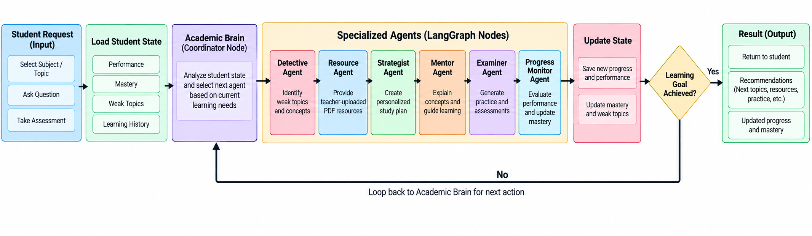
LANGRAPH ORCHESTRATION
LangGraph is used to coordinate the AI agents. It controls the workflow by selecting the right agent based on the student's current learning state and manages the flow between agents.

Slide 7
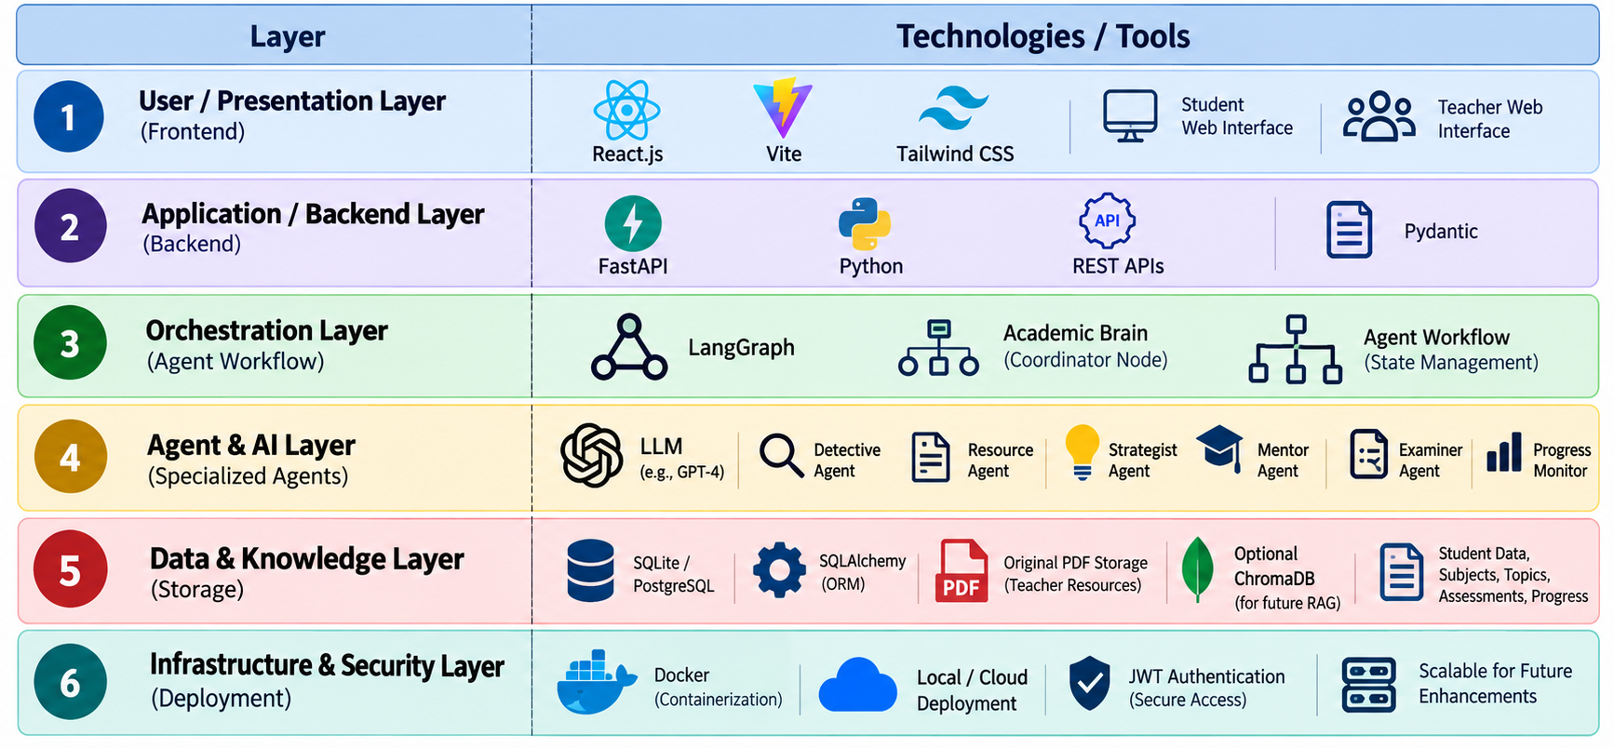
TOOLS AND TECHNOLOGIES USED

Slide 8
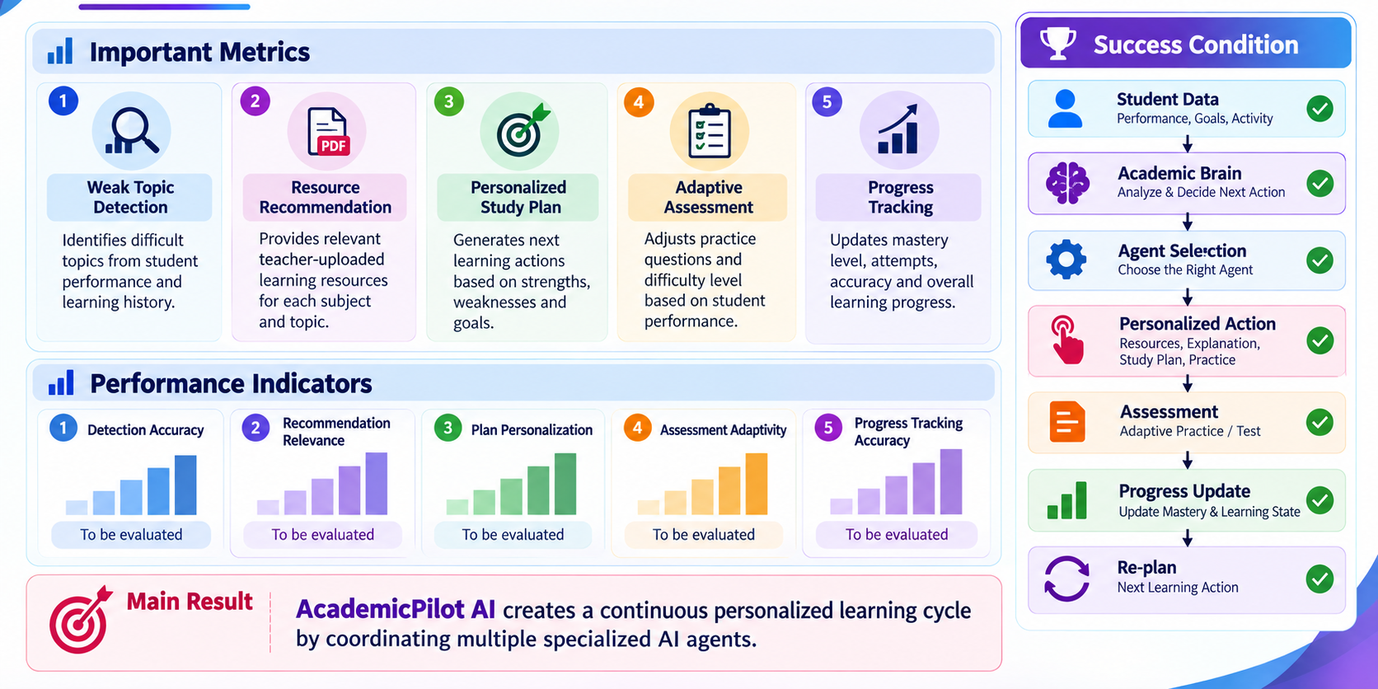
Performance & Metrics

Slide 9
FUTURE WORK
Integrate more advanced LLM models for better explanations and reasoning.
Add voice-based learning and multilingual support.
Improve personalized recommendations using larger student learning histories.
Add advanced RAG-based knowledge retrieval for learning content.
Develop mobile application support.
Provide advanced analytics and dashboards for teachers.
Improve scalability for larger numbers of students and courses.
CONCLUSION
AcademicPilot AI provides personalized and adaptive learning using a multi-agent architecture.
LangGraph coordinates the Academic Brain and specialized agents.
The system identifies weak topics, provides resources, creates study plans, supports learning, and evaluates progress.
Teachers can manage subjects, topics, and original PDF learning resources.

